Slide 1


Final Project by: Zvi Amosi and Alexey Serdtse
Big Data Engineering

Slide 2


Authors
Zvi Amosi
BI Developer and Analyst Ayalon Insurance Company Ltd.
Alexey Serdtse
ETL Developer Naya Technologies (Nice Ltd.)

Slide 3
A large retail network is required to publish product prices within an hour of updates.
The published data includes: prices, promotions, chain name, branch, date, and time.
At the end of each day, the data is deleted, and no historical record is kept.
Currently, at least two apps utilize this data.
No one tracks or displays historical changes over time.
Background

Slide 4
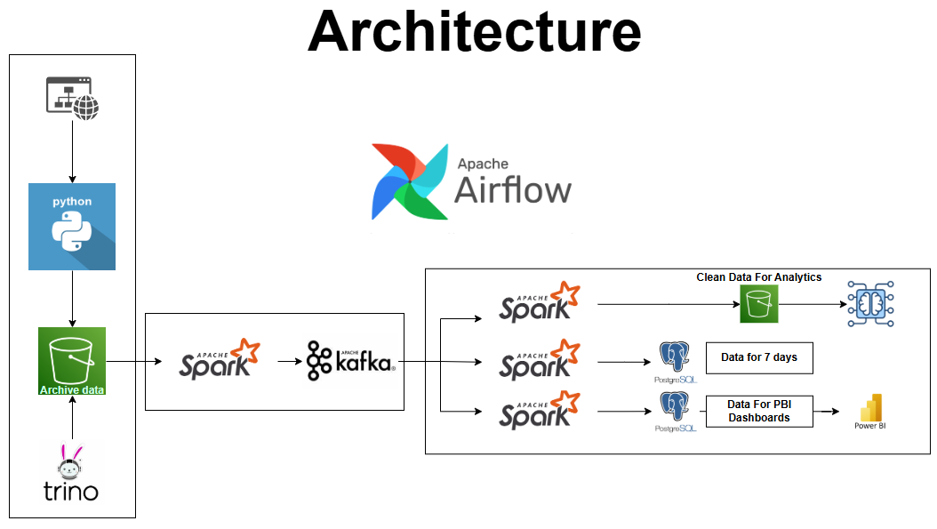

Slide 5
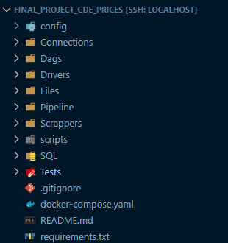
Project Structure
Configuration file – Configuration files that hold connection params: secrets/access keys, bootstrap servers, and other environment-specific configurations.
Connections – Reusable functions and utilities for establishing connections to external services i.e. databases, buckets etc.
DAGS - Definitions for orchestrating workflows.
Drivers - Drivers required for interacting with external tools.
Pipeline – The core pipeline logic for processing, transforming, and loading data.
Scrapper - Script for web scraping and extracting data from external website.
Tests – Testing validity and existence of components required to correct run of code.
Requirements - Lists Python dependencies required for the project, which can be installed using “pip install –r “

Slide 6
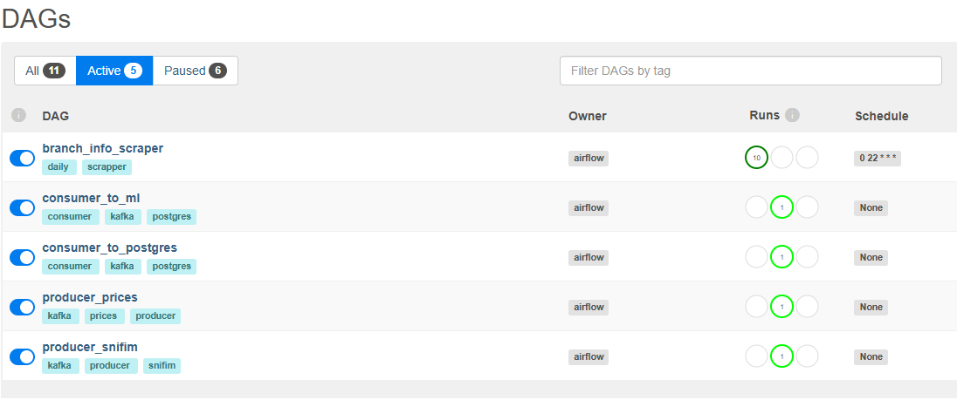
List of DAGs
branch_info_scrapper: runs daily in 10 p.m
Other producers / consumers are always-on, waiting for new data from scrapper.

Slide 7
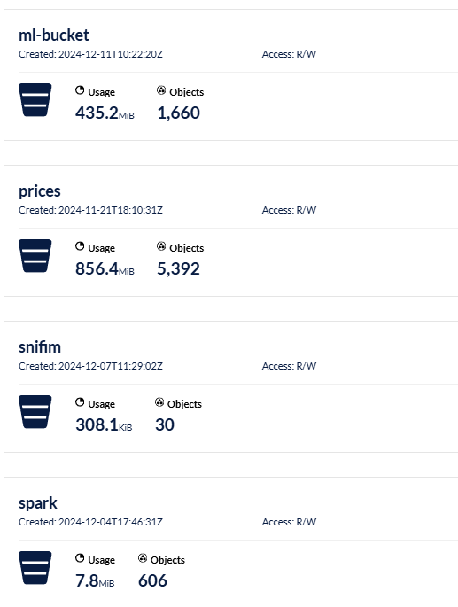
List of Buckets

Slide 8
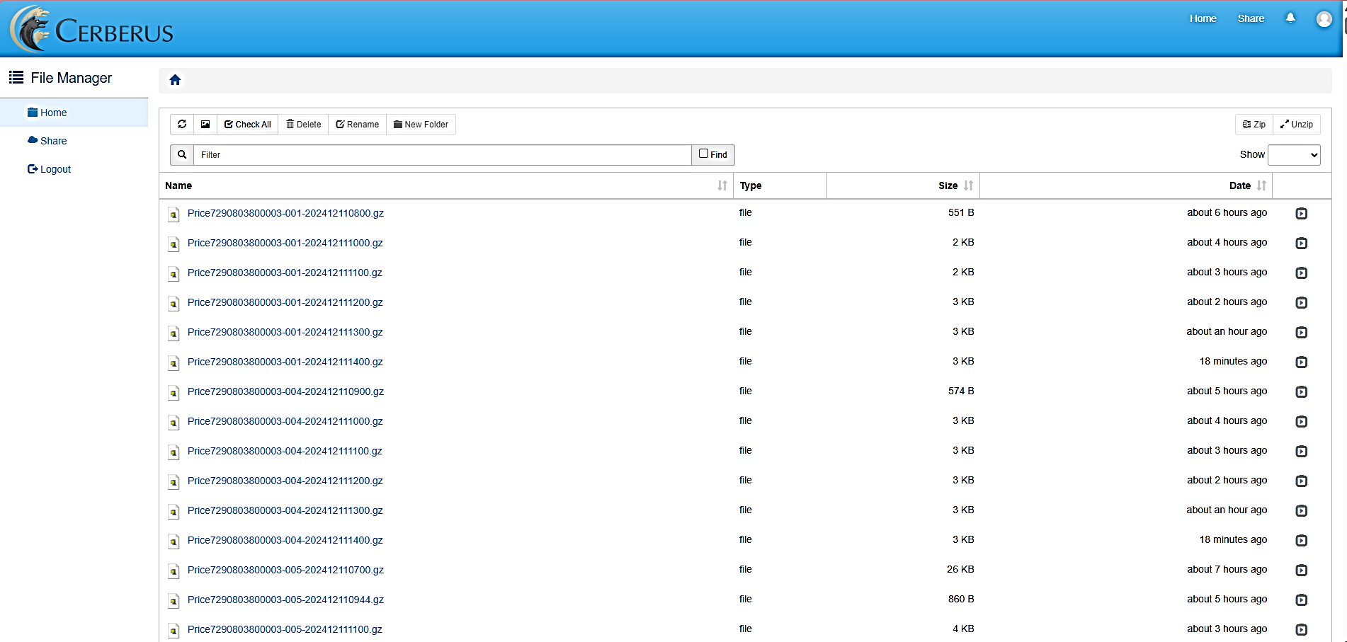
Source Of Data
URL: https://url.publishedprices.co.il/file/d/ Username: yohananof

Slide 9
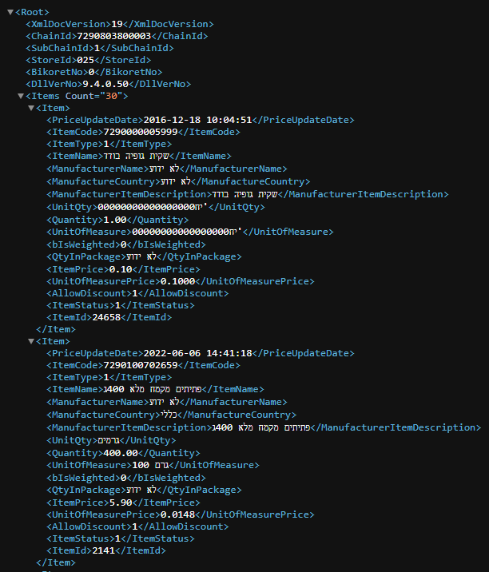
Source Of Data
XML File inside every zip file

Slide 10
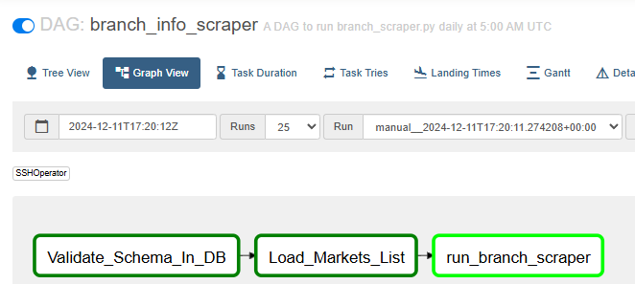
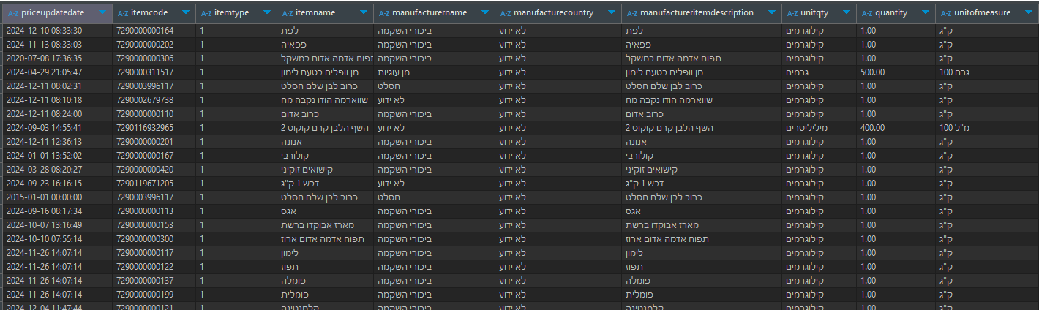
Import Data To Archive Buckets
Scraping Mechanism:
A scrapper iterates over all providers and branch daily data. Using BS4, Selenium and Chrome web driver.
Extracts pricing data and stores it in a “prices” bucket. Only new files!
Data Format:
Data is saved in Parquet files with Snappy compression for efficient storage and retrieval.
Orchestration:
Automated with Airflow, ensuring a scheduled daily run.

Slide 11
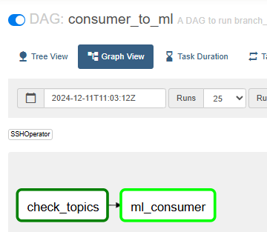
Pipeline – 1: Prepare data for ML
Read streams of “Prices” and “Snifim” and gets data from “Reshatot”.
Enrich dataset by broadcast join between the datasets
Filters for specific columns from both datasets.
Ensure clean data:
“itemcode” is not null.
“last_update_date” is not null
Add columns:
“days_since_last_price_update”
“is_price_update_stale”
“snapshot”
“snapshot_month”
“snapshot_quarter”
“is_weekend”
Snifim description columns
Ensure both topics exists in kafka
Read new data only

Slide 12
Pipeline – 4: Zip all files older than 7 days
Steps:
Identify Buckets: Focus on "prices" and "snifim" buckets.
File Age Check: Locate files older than 7 days.
Archive Old Files: Move identified files into a zip archive for compression.
Outcome: Minimize storage usage and reduce costs.

Slide 13


Github Repository
Link to repository: https://github.com/zamosi/final_project_CDE_prices

Slide 14


